Slide 1
Integration on Facebook via Dialogflow
By: Fahim Uz Zaman and Alifya Hussain

Slide 2
Prerequisite
Facebook Page
Chatbot on Dialogflow

Slide 3
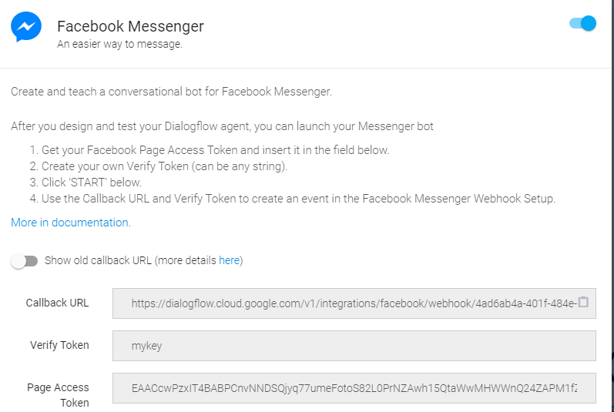
Integration on Dialogflow

Slide 4
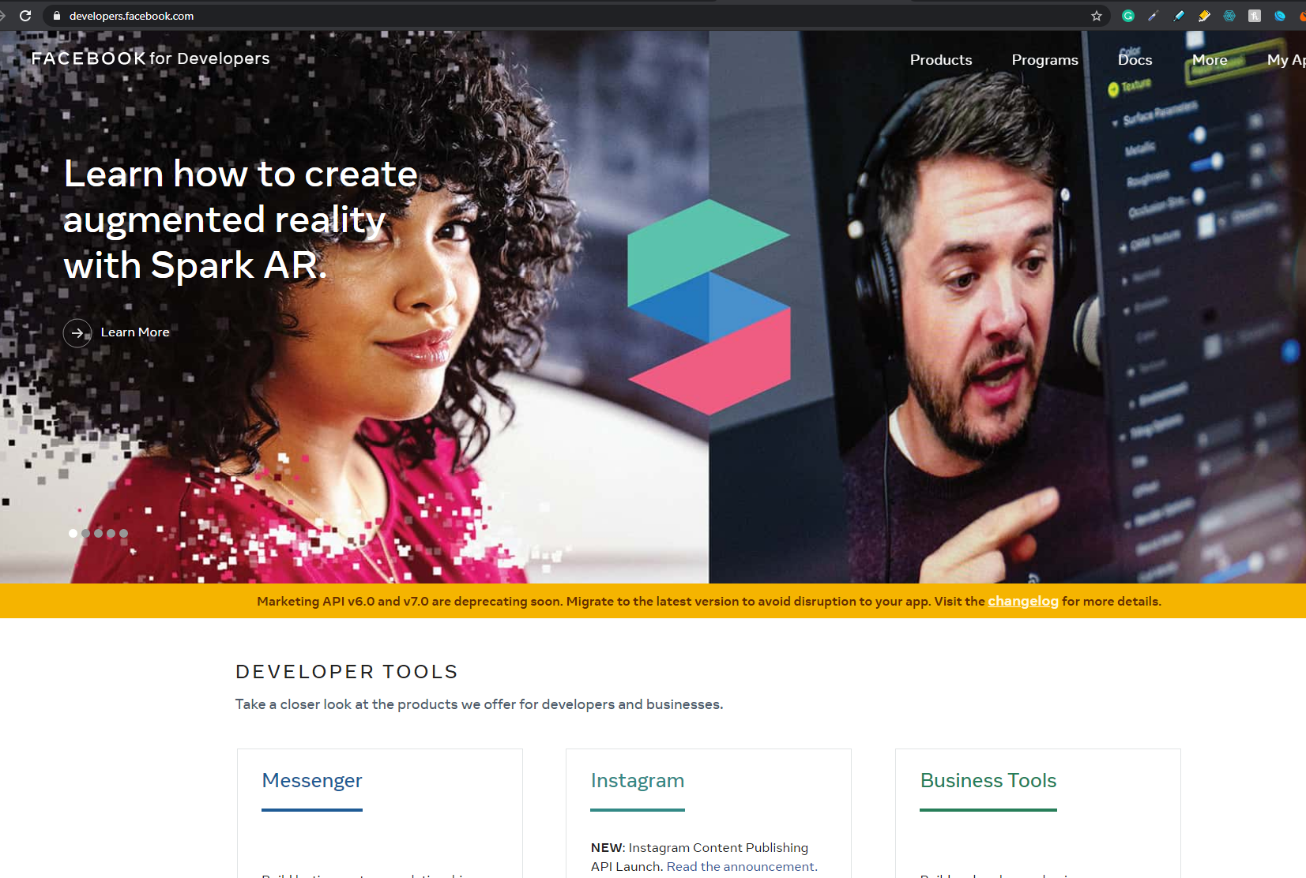
Facebook Developer Page

Slide 5
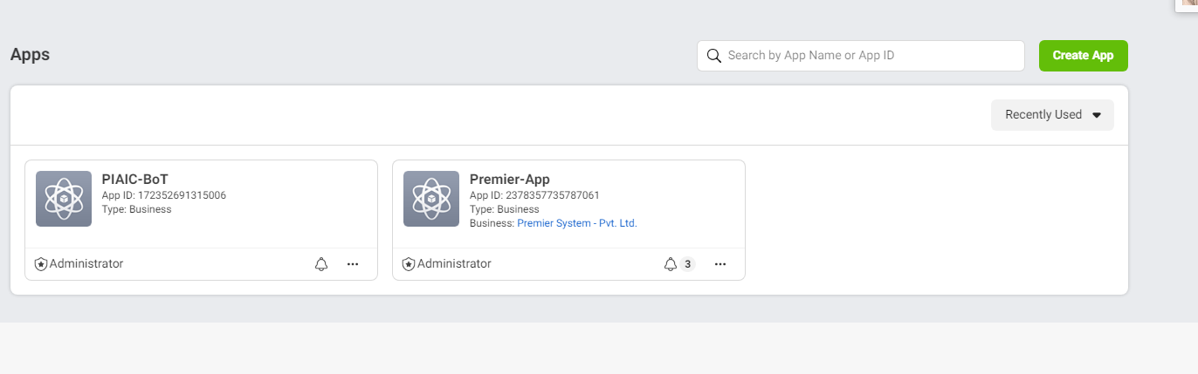
Create a new App

Slide 6
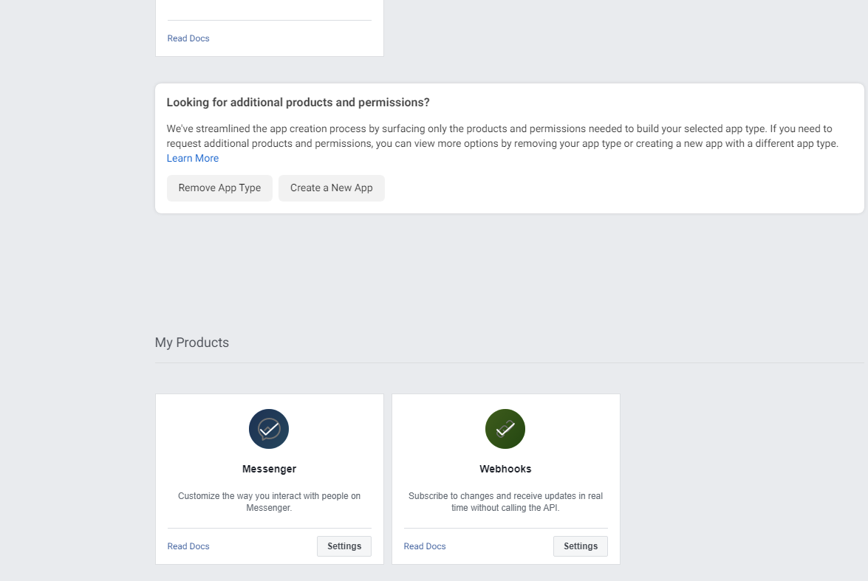
Add the messenger

Slide 7
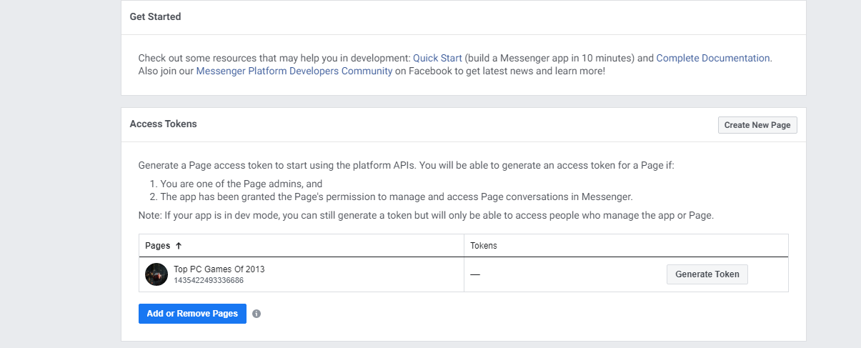
Add the fb page in your app

Slide 8
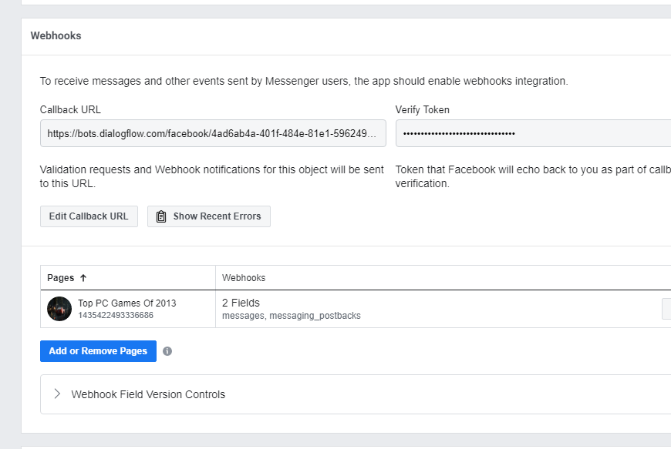
Add the webhook next

Slide 9
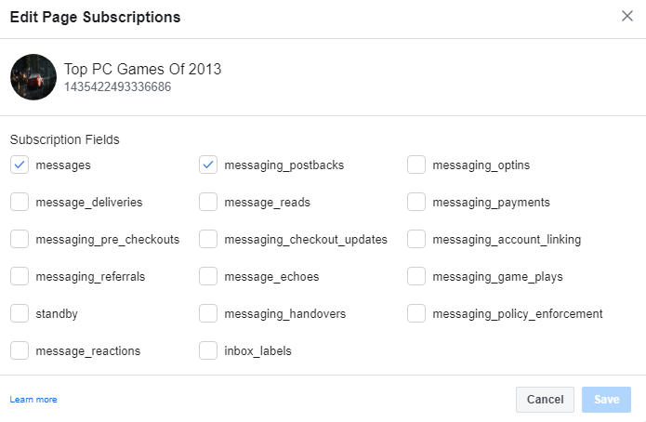
Now edit the subscription

Slide 10
Thanks

